Slide 2
Cause for research
An air monitor is assumed to uniformly represent the air quality of the area around it. Probability analyses of combining background concentrations with model-predicted concentrations.
After taking into account potential confounding by other pollutants, we found consistent evidence that the level of PM₁₀ is associated with the rate of death from all causes and from cardiovascular and respiratory illnesses. The estimated increase in the relative rate of death from all causes was 0.51 percent (95 percent posterior interval, 0.07 to 0.93 percent) for each increase in the PM₁₀ level of 10 μg per cubic meter.
Data on levels of PM_{2.5} are not yet available nationally, since a monitoring network for particles in this size range is currently being implemented.

Slide 3
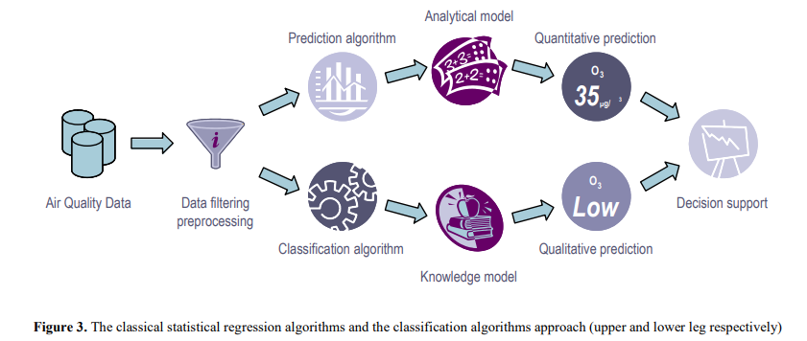
Methodology

Slide 4
Classification
Classification and prediction are two forms of data analysis that can be used to extract models describing important data classes or to predict future data trends . Classification predicts categorical labels, the co-called "classes", while prediction models are used for forecasting continuous valued variables. Basically, both classification and prediction analyses are a two-step process.
In the first step, a classification/prediction algorithm is applied on the available data and a decision model is extracted.
The second step is the testing phase, which involves the application of the decision model on data for making decisions (predictions).
In this respect, both classification and statistical prediction algorithms have been applied for function approximation in several, yet diverse, domains.

Slide 5
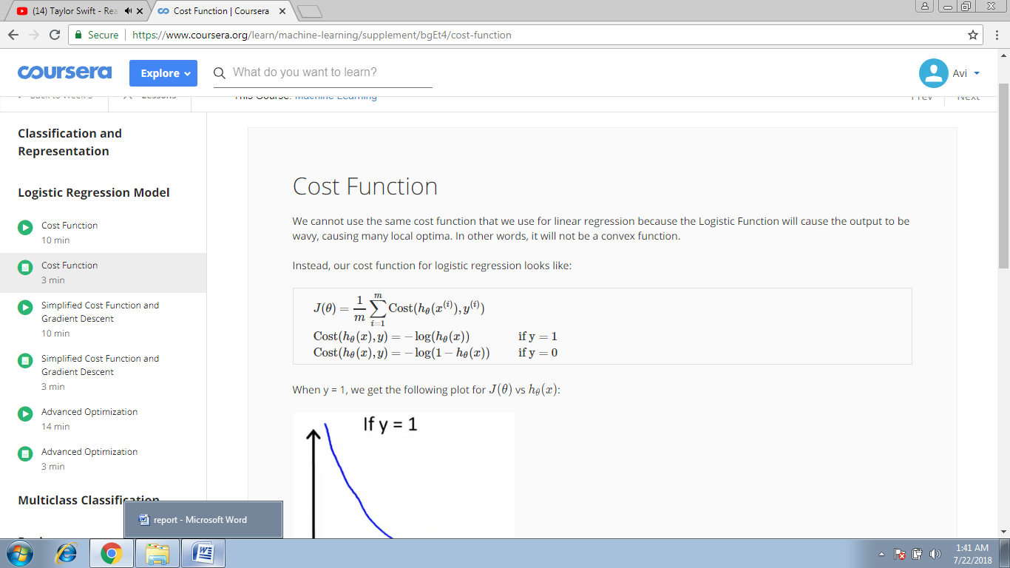
Formula for Hypothesis Cost function
To measure the accuracy of hypothesis cost function is used. Cost function for Logistic Regression algorithm is :
Cost function makes it sure that J(ϴ) is convex( i.e. has single global optima) for classification.
Gradient Descent:
It is used to calculate parameters value(i.e. ϴ) for hypothesis function. We need to find parameters values such that they give minimum cost function value.

Slide 6
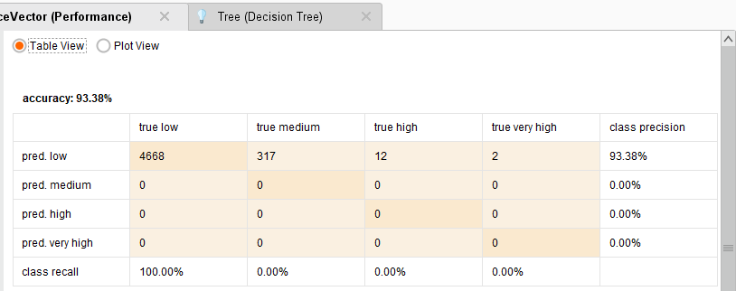
Output for No2

Slide 7
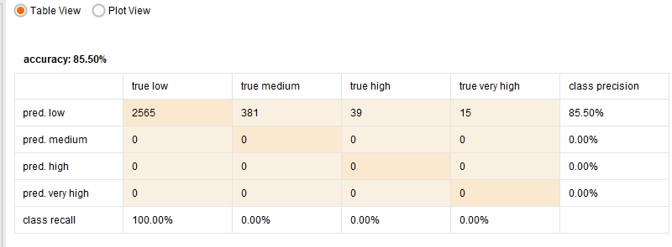
Output for So2

Slide 8
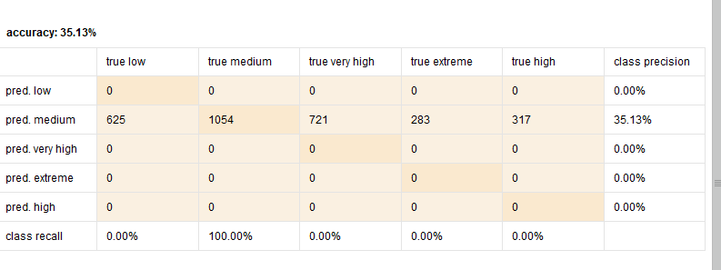
Output for RSPM

Slide 9
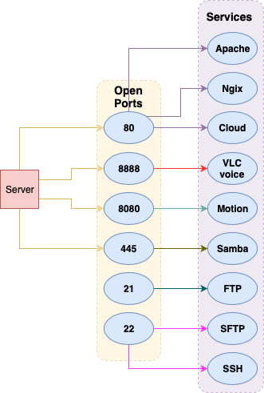
Ports utilised by server

Slide 10
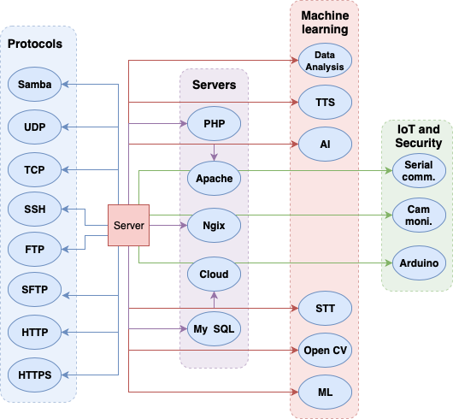
Services

Slide 11
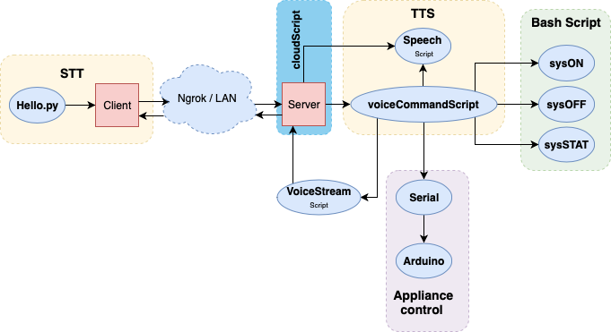
TTS and SST

Slide 12
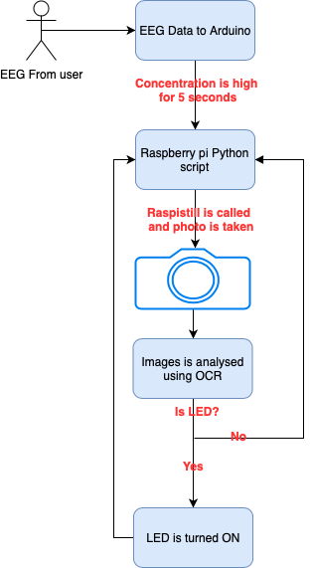
Mind controlled functionality

